Slide 1
300 North La Salle
Liam McNamara
BAE / MAE
Senior Thesis
April 13th, 2010

Slide 2
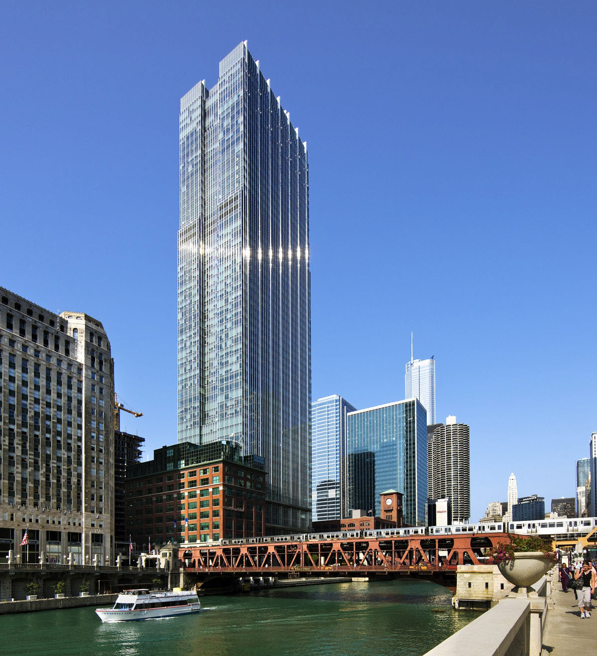
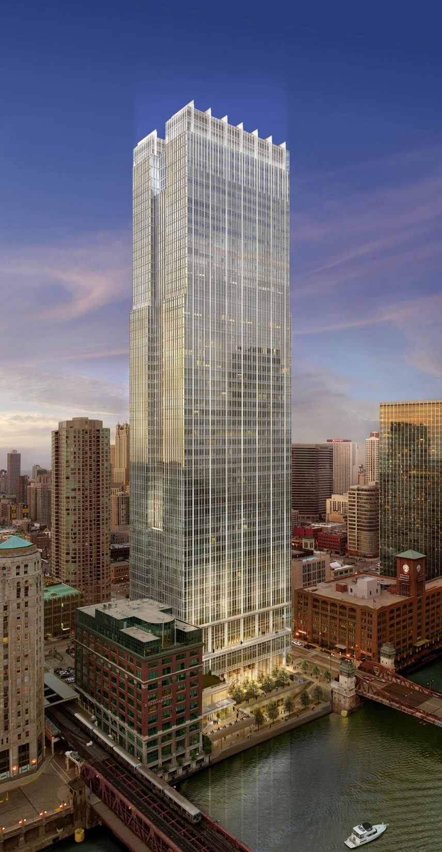
300 North La Salle
Existing Structure
Goals
Lateral Redesign
  1st Iteration
  2nd & 3rd Iterations
  Final Design
Architectural Impact
Acoustic Impact
Questions?
300 North La Salle
Chicago, Illinois
Owner: Hines
Structural Engr: Magnusson Klemencic Assc.
Architect: Pickard Chilton Architects, Inc.
Construction Dates: June 2006-Feb. 2009
Height : 775 ft
# of Stories: 57
Occupancy: Office / Retail
Size: 1.3 Million Square Feet
25,000 ft ² per floor
Cost: $230 Million - $177 / ft ²

Slide 3
300 North La Salle
Existing Structure
Goals
Lateral Redesign
  1st Iteration
  2nd & 3rd Iterations
  Final Design
Architectural Impact
Acoustic Impact
Questions?
Existing Structure

Slide 4
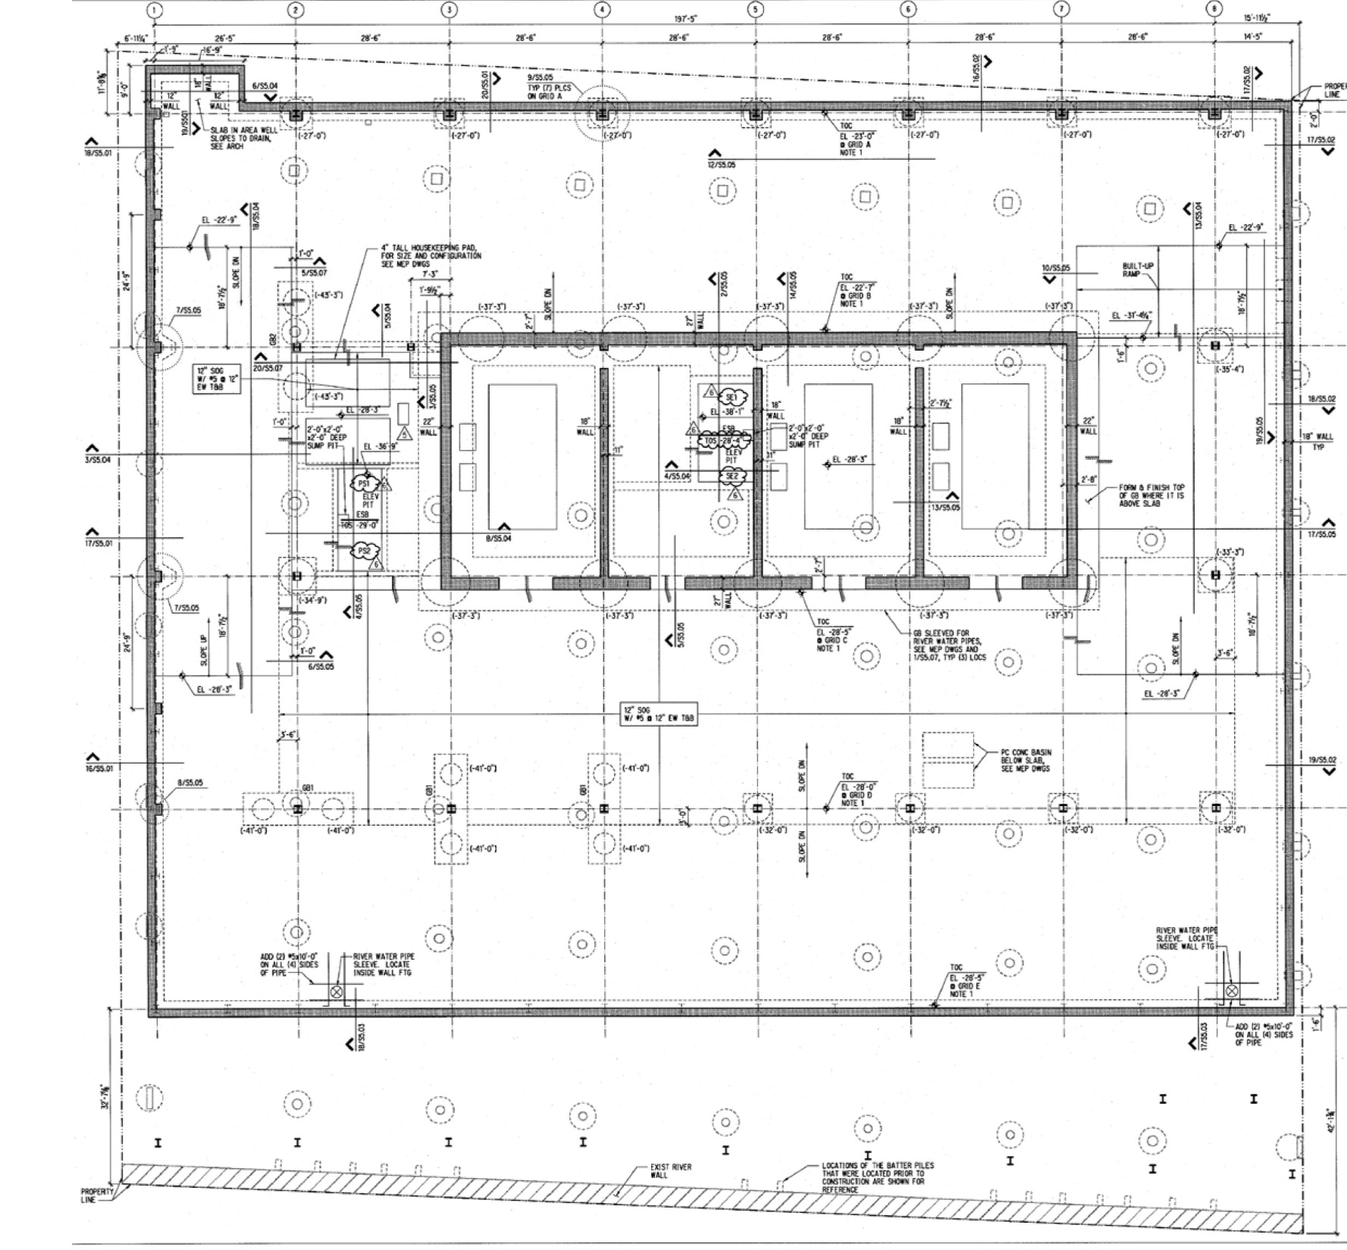
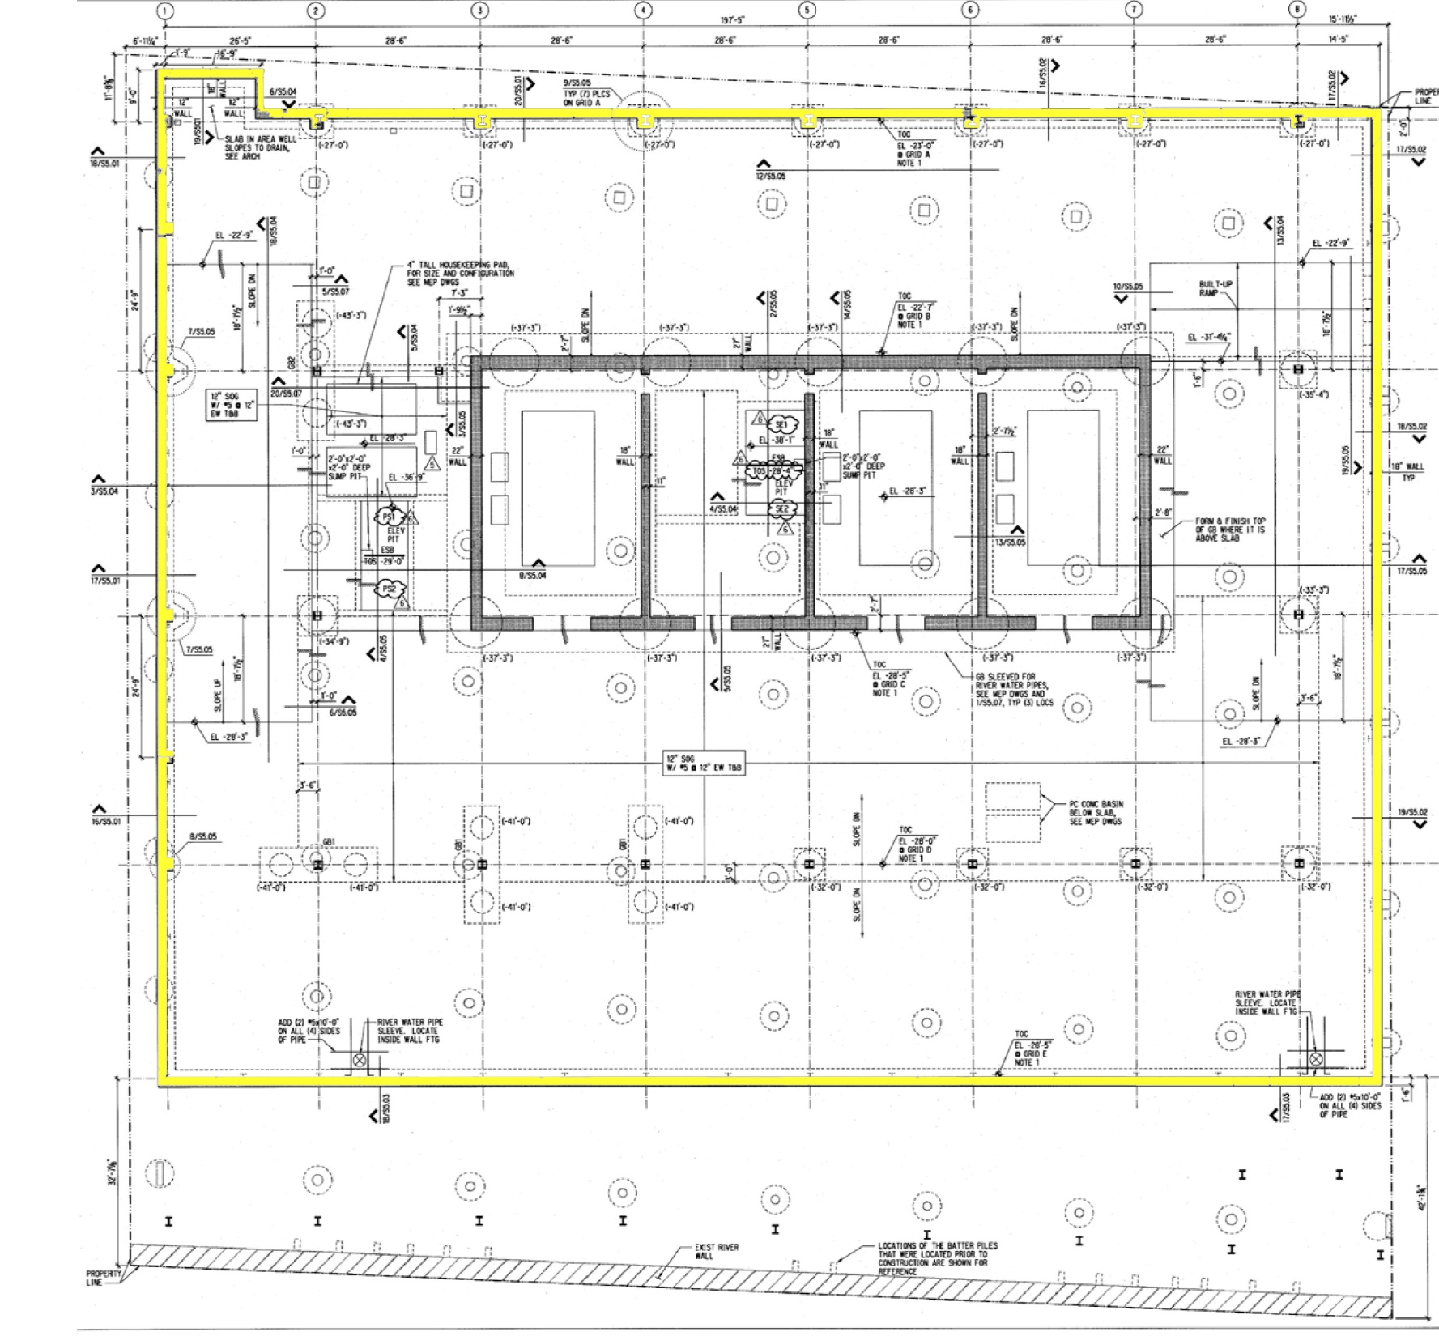
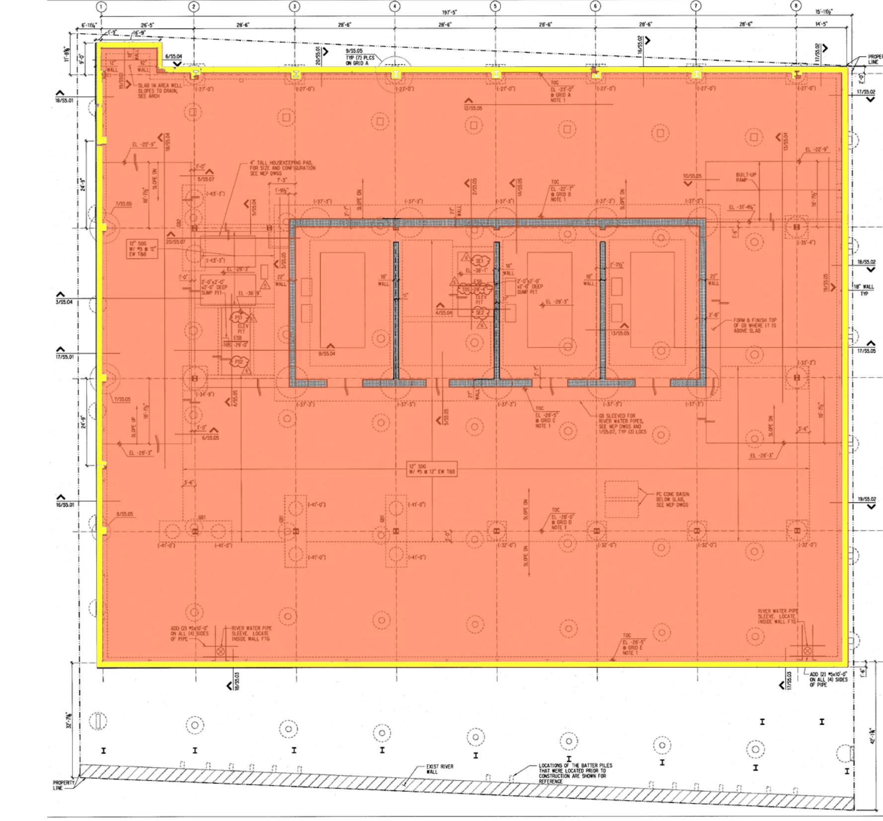
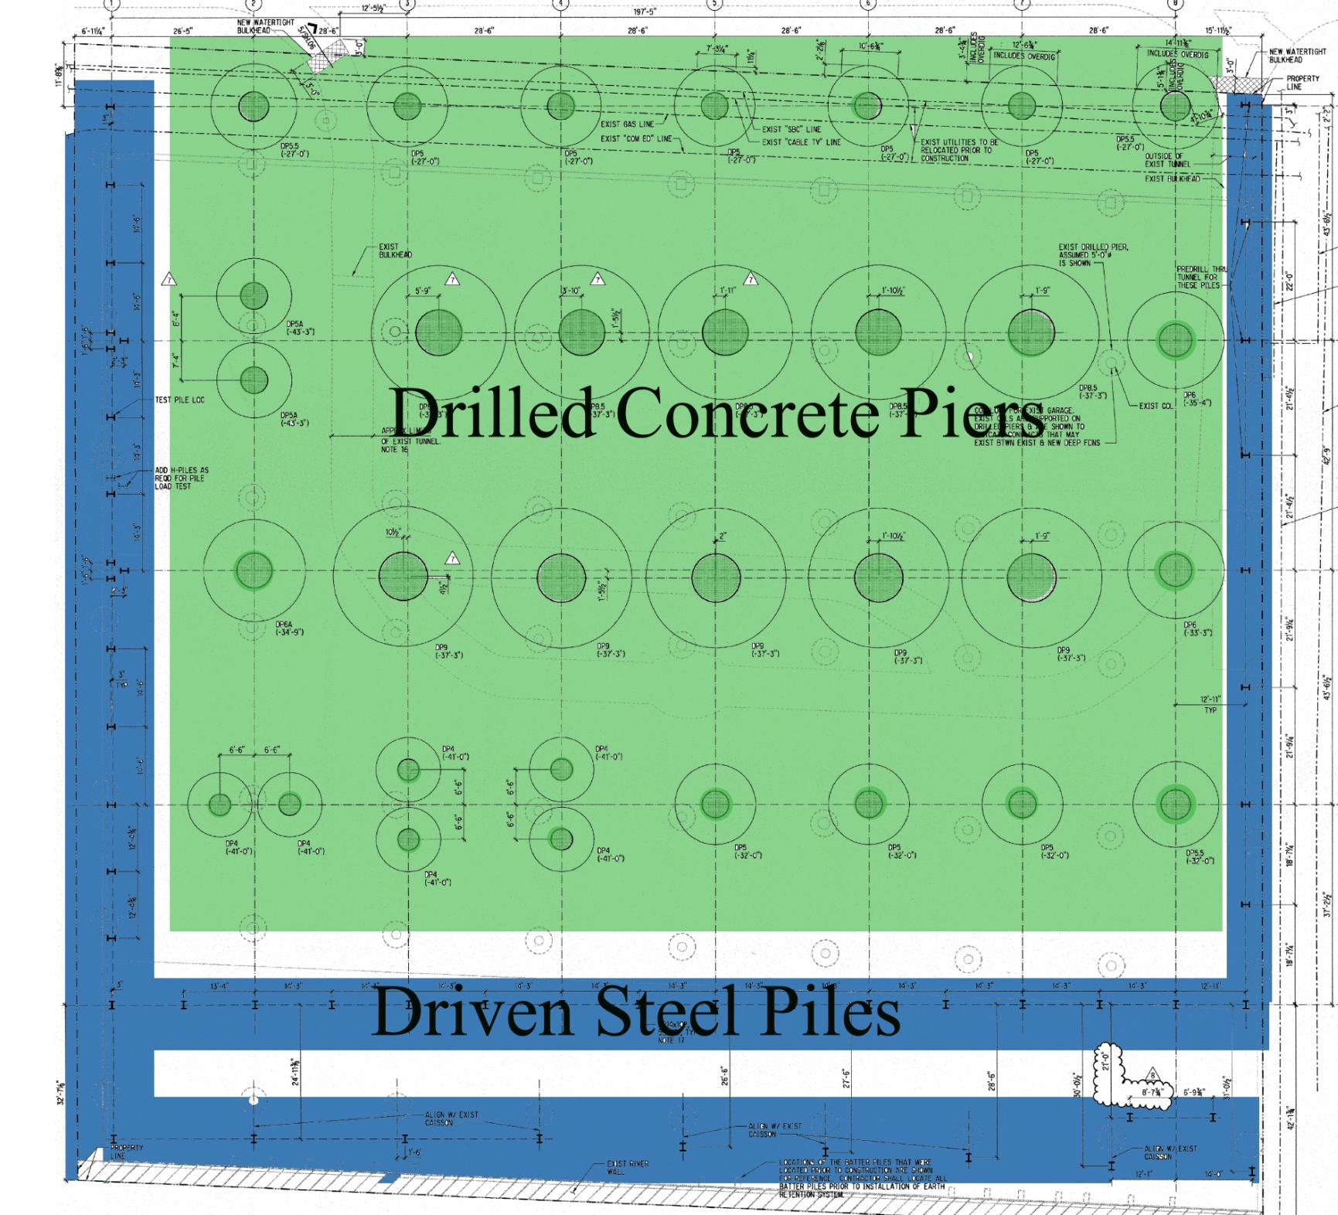
300 North La Salle
Existing Structure
Goals
Lateral Redesign
  1st Iteration
  2nd & 3rd Iterations
  Final Design
Architectural Impact
Acoustic Impact
Questions?
Foundation:
  3-sub grade parking levels
  18” cast-in-place walls
  12” cast-in-place slab
  Drilled Concrete Piers
  Driven steel H-Piles
Foundation

Slide 5
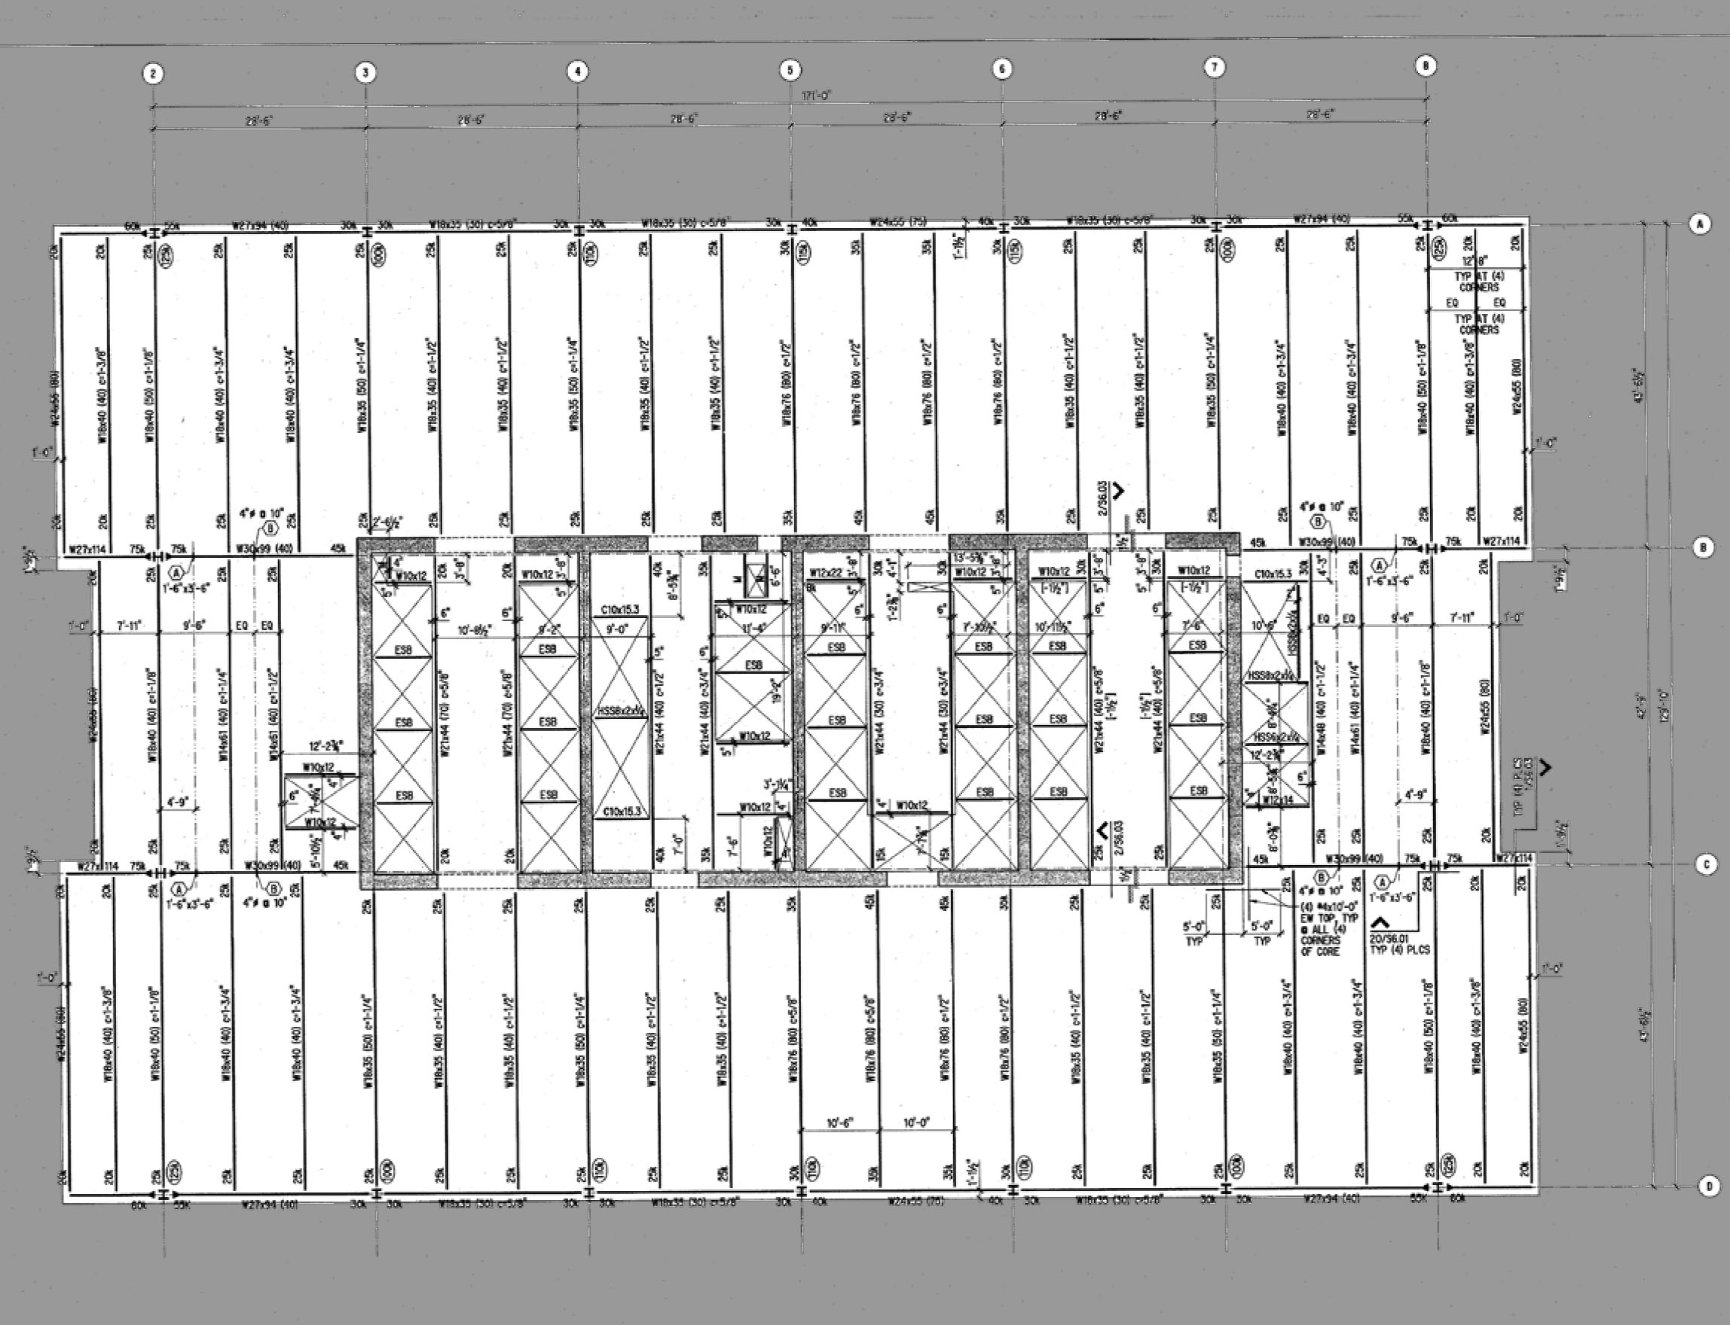
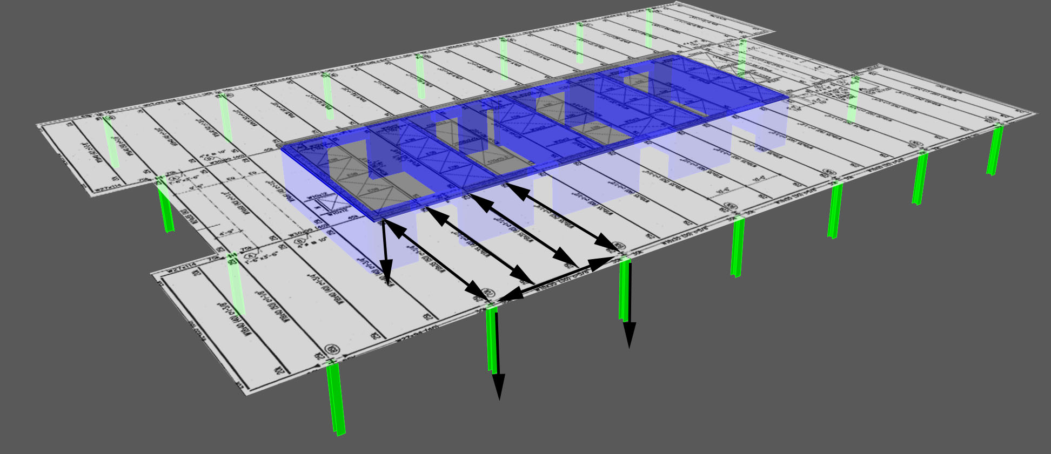
300 North La Salle
Existing Structure
Goals
Lateral Redesign
  1st Iteration
  2nd & 3rd Iterations
  Final Design
Architectural Impact
Acoustic Impact
Questions?
Gravity System:
  Typical 28’-6” x 43’-6” bays supported by W18x35 beams and W18x50 girders
  Typical 3” slab on 3” composite steel deck
  Concrete Bearing Wall Core
  Steel W-shape Columns
Gravity System

Slide 6
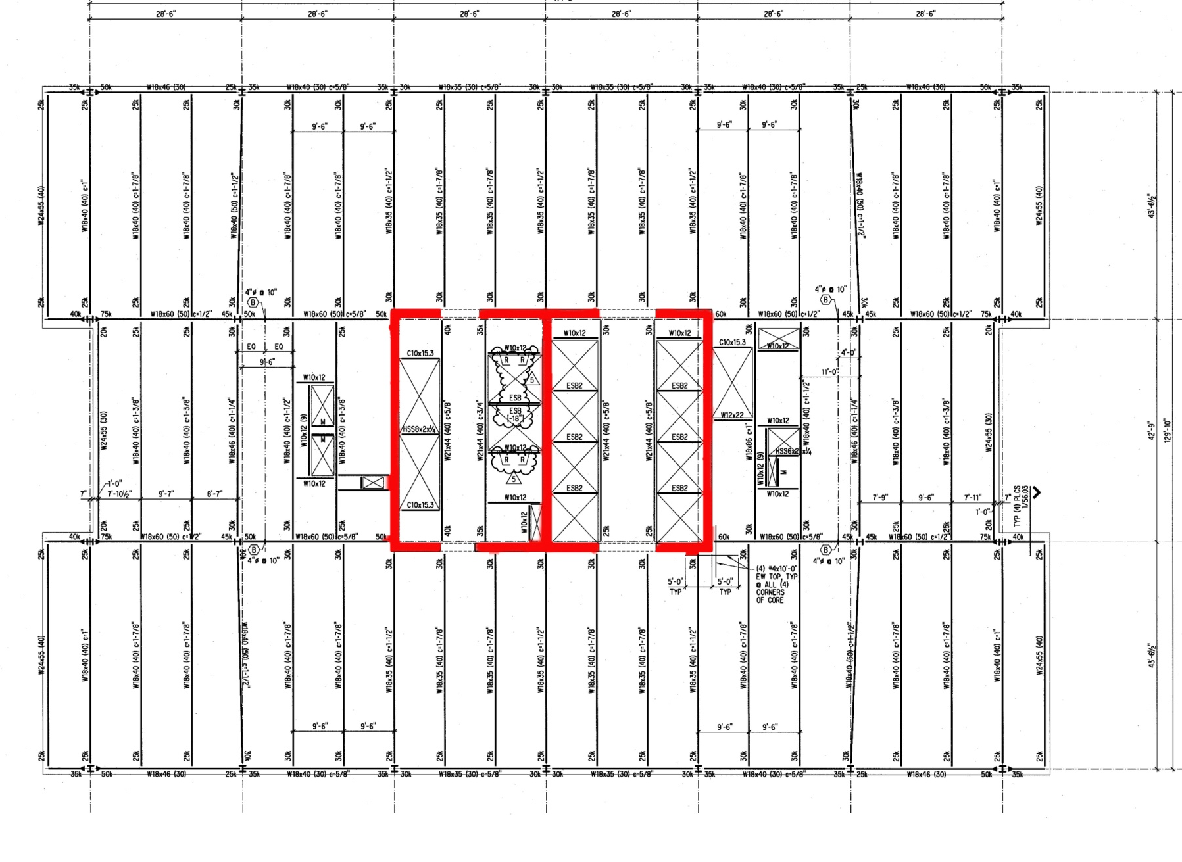
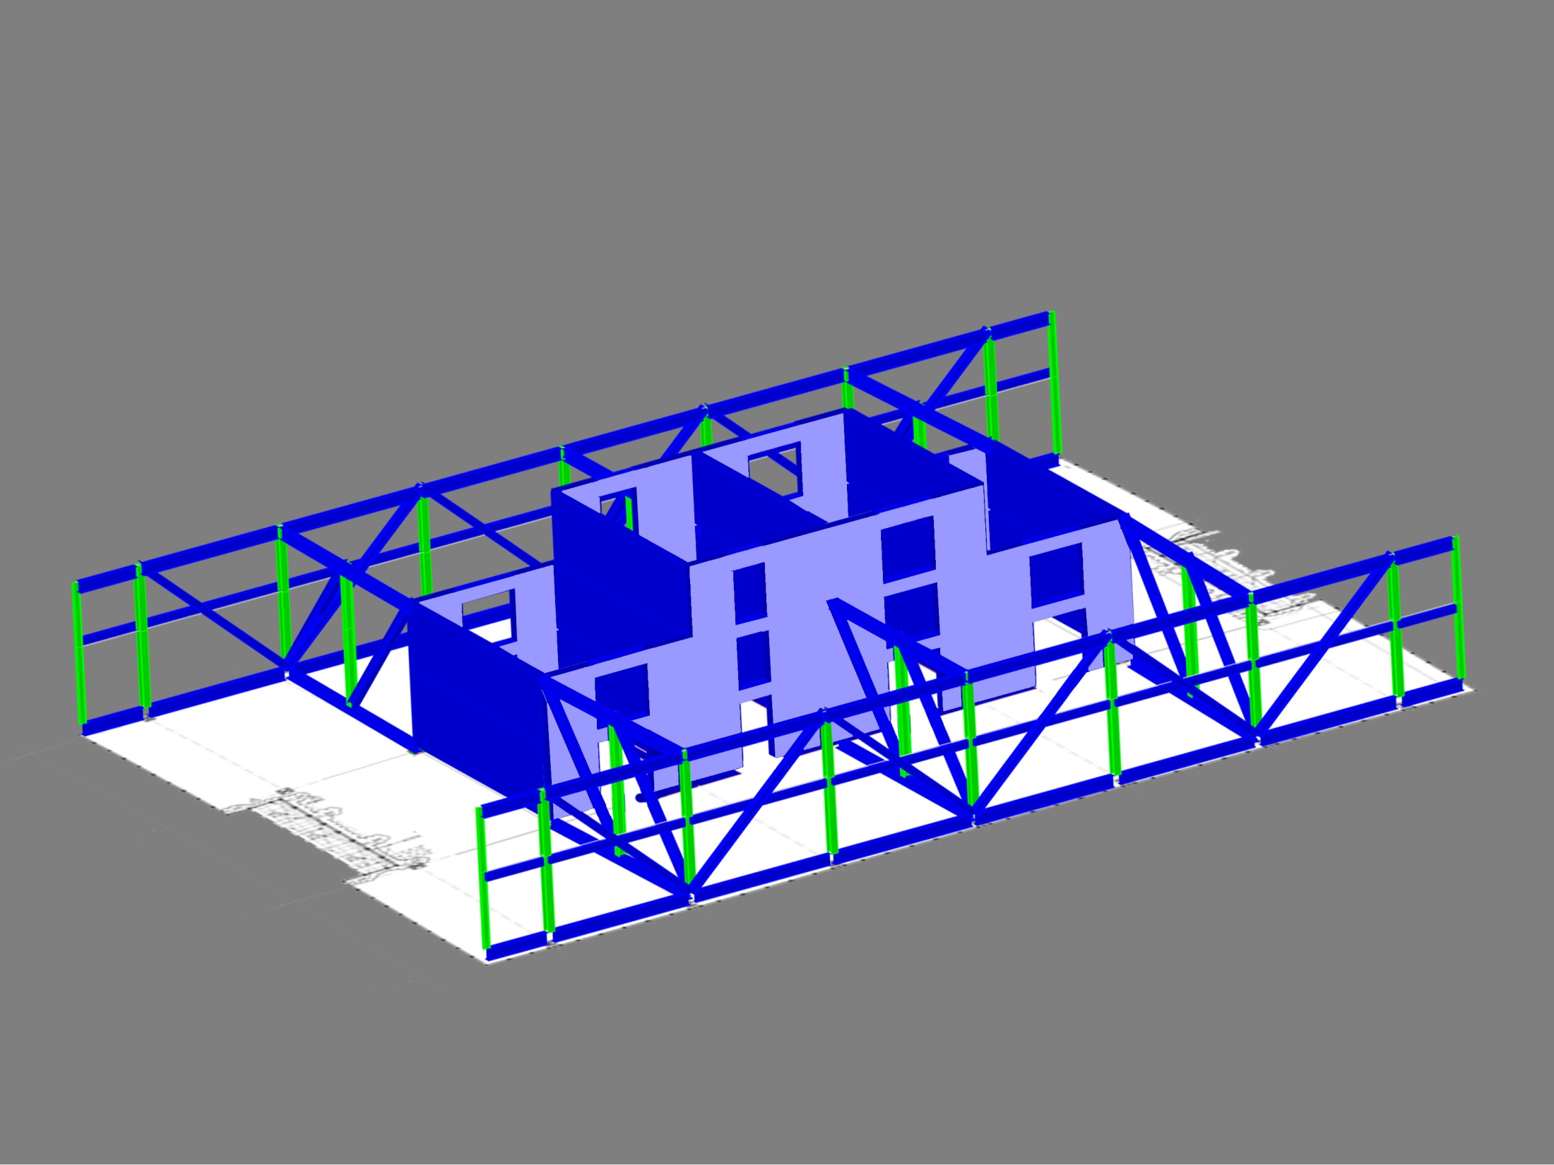
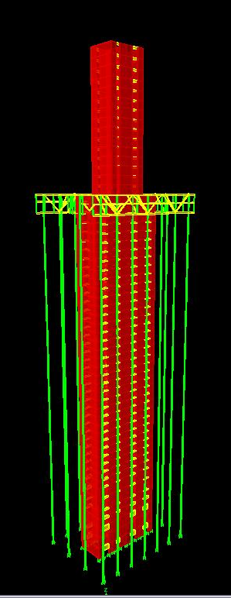
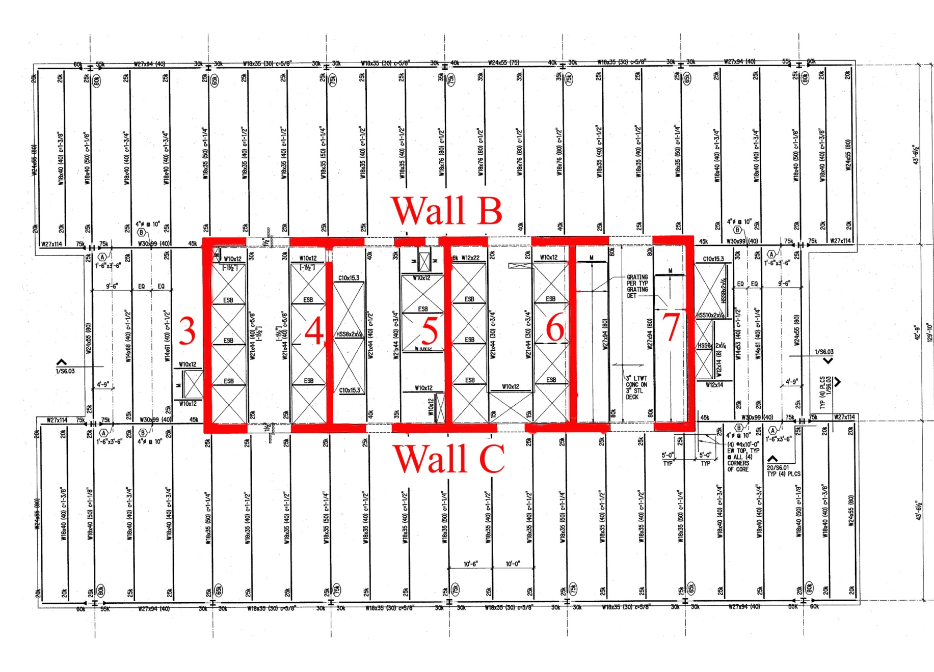
300 North La Salle
Existing Structure
Goals
Lateral Redesign
  1st Iteration
  2nd & 3rd Iterations
  Final Design
Architectural Impact
Acoustic Impact
Questions?
Lateral System:
  Concrete Core – f’c 6-10 ksi
  Typical Bays 28’-6” x 42’-9”
  4 bays : Lower Level 4- Level 42
  2 bays : Level 43 - 58
  6 Outrigger Trusses - Level 41-43
  2 Belt Trusses – Level 41-43
Lateral System

Slide 7
300 North La Salle
Existing Structure
Goals
Lateral Redesign
  1st Iteration
  2nd & 3rd Iterations
  Final Design
Architectural Impact
Acoustic Impact
Questions?
Goals

Slide 8
300 North La Salle
Existing Structure
Goals
Lateral Redesign
  1st Iteration
  2nd & 3rd Iterations
  Final Design
Architectural Impact
Acoustic Impact
Questions?
Goals
Reduce foot print of core
Redesign structural core
Eliminate belt trusses
Increase rentable floor space
Comply with original architecture

Slide 9
300 North La Salle
Existing Structure
Goals
Lateral Redesign
  1st Iteration
  2nd & 3rd Iterations
  Final Design
Architectural Impact
Acoustic Impact
Questions?
Things to Consider:
  Minimize inherent torsion
  Control wind drift
  Control wind acceleration
  Strength and Constructability
    Walls
    Beams
Lateral Redesign

Slide 10
300 North La Salle
Existing Structure
Goals
Lateral Redesign
  1st Iteration
  2nd & 3rd Iterations
  Final Design
Architectural Impact
Acoustic Impact
Questions?
1st Iteration

Slide 11
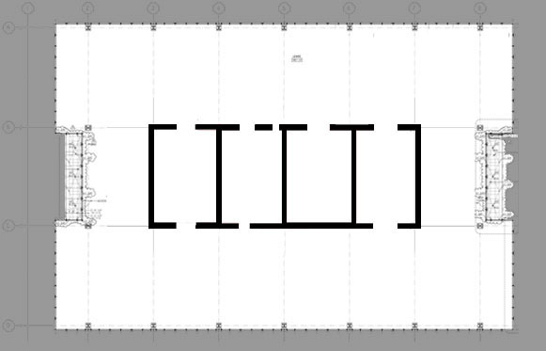
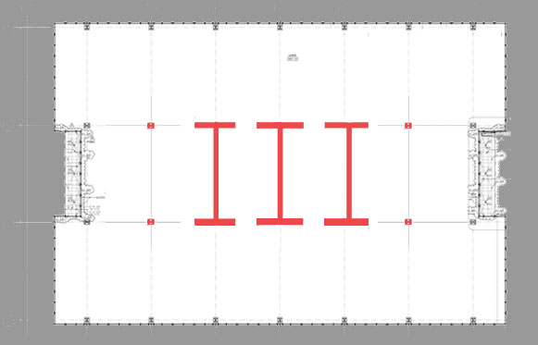

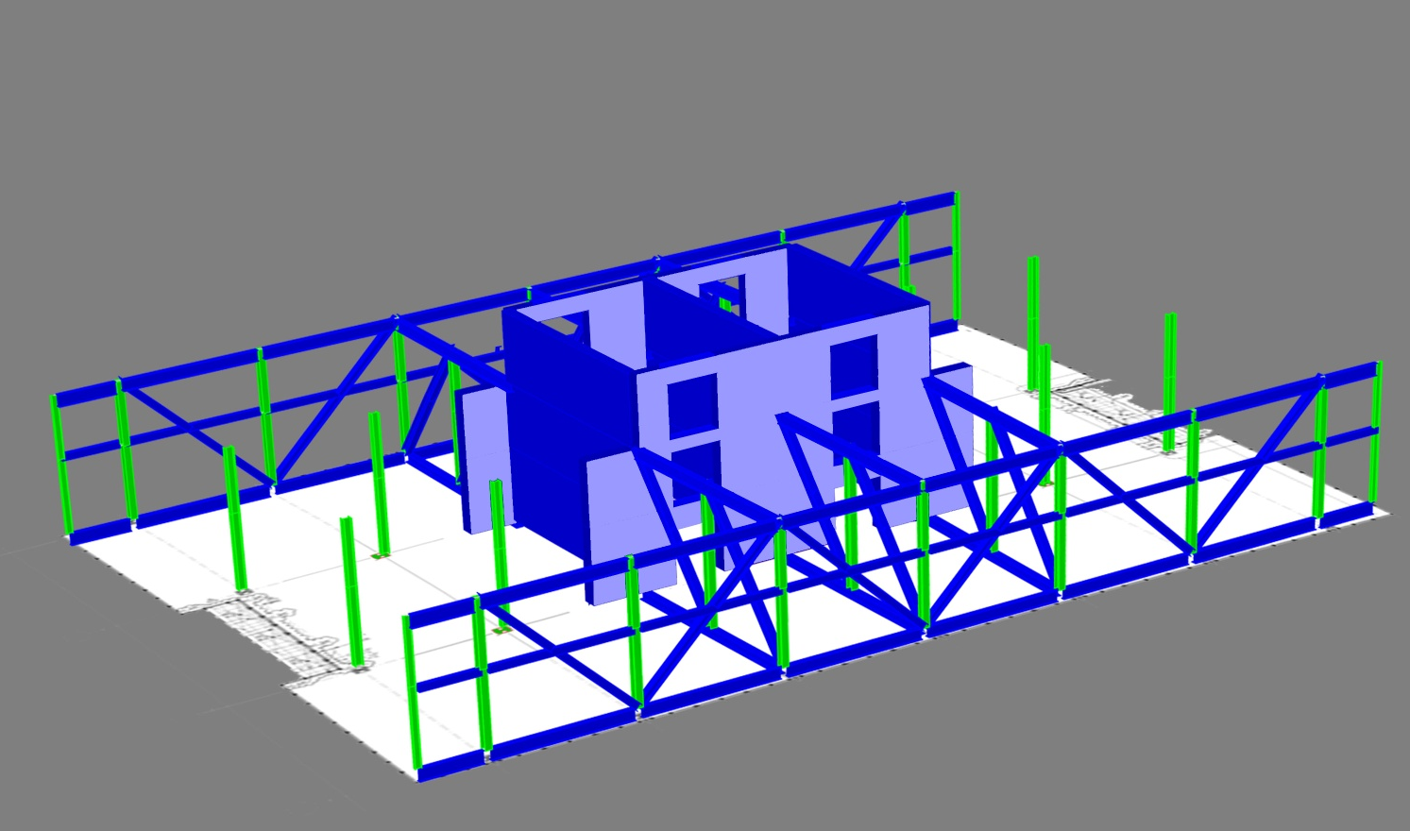
300 North La Salle
Existing Structure
Goals
Lateral Redesign
  1st Iteration
  2nd & 3rd Iterations
  Final Design
Architectural Impact
Acoustic Impact
Questions?
Key Points:
  3 I shapes
  4 – 10’ openings
  Walls 4,5,6 : 30” thick
  Walls B & C : 27”, 21”, 18” thick decreasing at Lvl 9 & 43
  Reposition Outriggers

Slide 12
300 North La Salle
Existing Structure
Goals
Lateral Redesign
  1st Iteration
  2nd & 3rd Iterations
  Final Design
Architectural Impact
Acoustic Impact
Questions?
Results:
  Periods of Vibration
    Ty = 7.8 sec → 10% increase
    Tx = 8.32 sec → 47% increase
    Tz = 8.51 sec → 53% increase

Slide 13
300 North La Salle
Existing Structure
Goals
Lateral Redesign
  1st Iteration
  2nd & 3rd Iterations
  Final Design
Architectural Impact
Acoustic Impact
Questions?
Things to Consider:
  Minimize inherent torsion
  Control wind drift
  Control wind acceleration
  Strength and Constructability
    Walls
    Beams
1st Iteration

Slide 14
300 North La Salle
Existing Structure
Goals
Lateral Redesign
  1st Iteration
  2nd & 3rd Iterations
  Final Design
Architectural Impact
Acoustic Impact
Questions?
2nd & 3rd Iterations

Slide 15
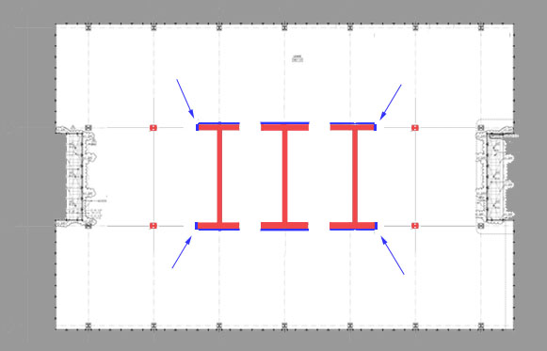
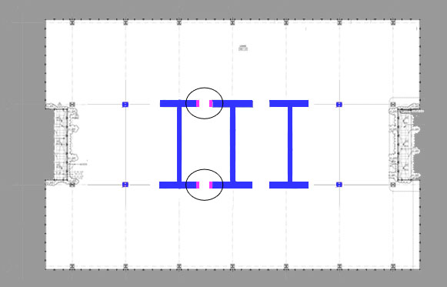
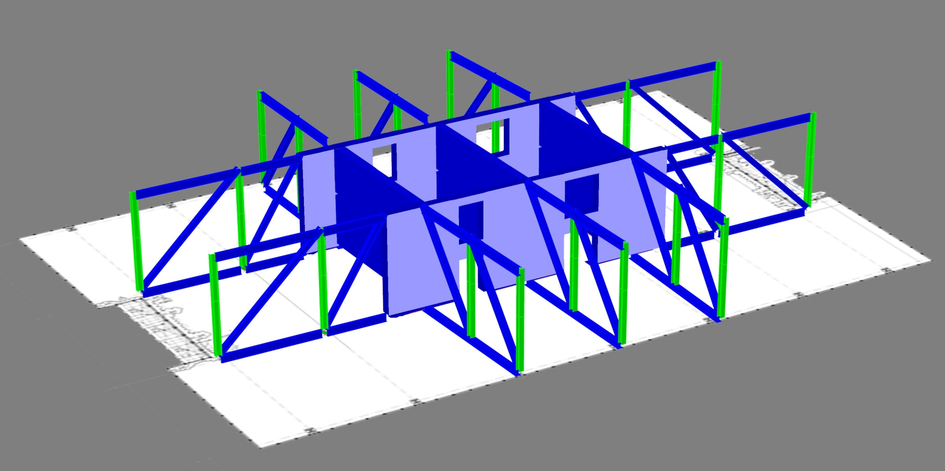
300 North La Salle
Existing Structure
Goals
Lateral Redesign
  1st Iteration
  2nd & 3rd Iterations
  Final Design
Architectural Impact
Acoustic Impact
Questions?
Key Points:
  New Truss Configuration
    No Belt trusses
    4 Additional Outriggers spanning East - West
  Increased Flange Length at Walls 4 & 6
  Increased wall thicknesses
  2 – 7’ openings
  2 – 10’ openings

Slide 16
300 North La Salle
Existing Structure
Goals
Lateral Redesign
  1st Iteration
  2nd & 3rd Iterations
  Final Design
Architectural Impact
Acoustic Impact
Questions?
Results:
  Peak Acceleration
    29 milli-g’s
  Periods of Vibration
    12.8% increase
    Target 10%

Slide 17
300 North La Salle
Existing Structure
Goals
Lateral Redesign
  1st Iteration
  2nd & 3rd Iterations
  Final Design
Architectural Impact
Acoustic Impact
Questions?
Things to Consider:
  Minimize inherent torsion
  Control wind drift
  Control wind acceleration
  Strength and Constructability
    Walls
    Beams
2nd & 3rd Iterations

Slide 18
300 North La Salle
Existing Structure
Goals
Lateral Redesign
  1st Iteration
  2nd & 3rd Iterations
  Final Design
Architectural Impact
Acoustic Impact
Questions?
Final Design

Slide 19
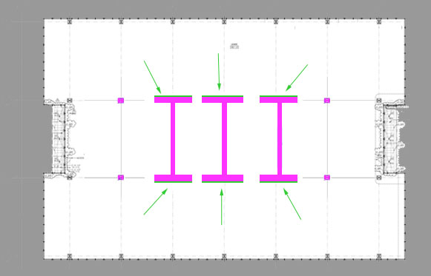
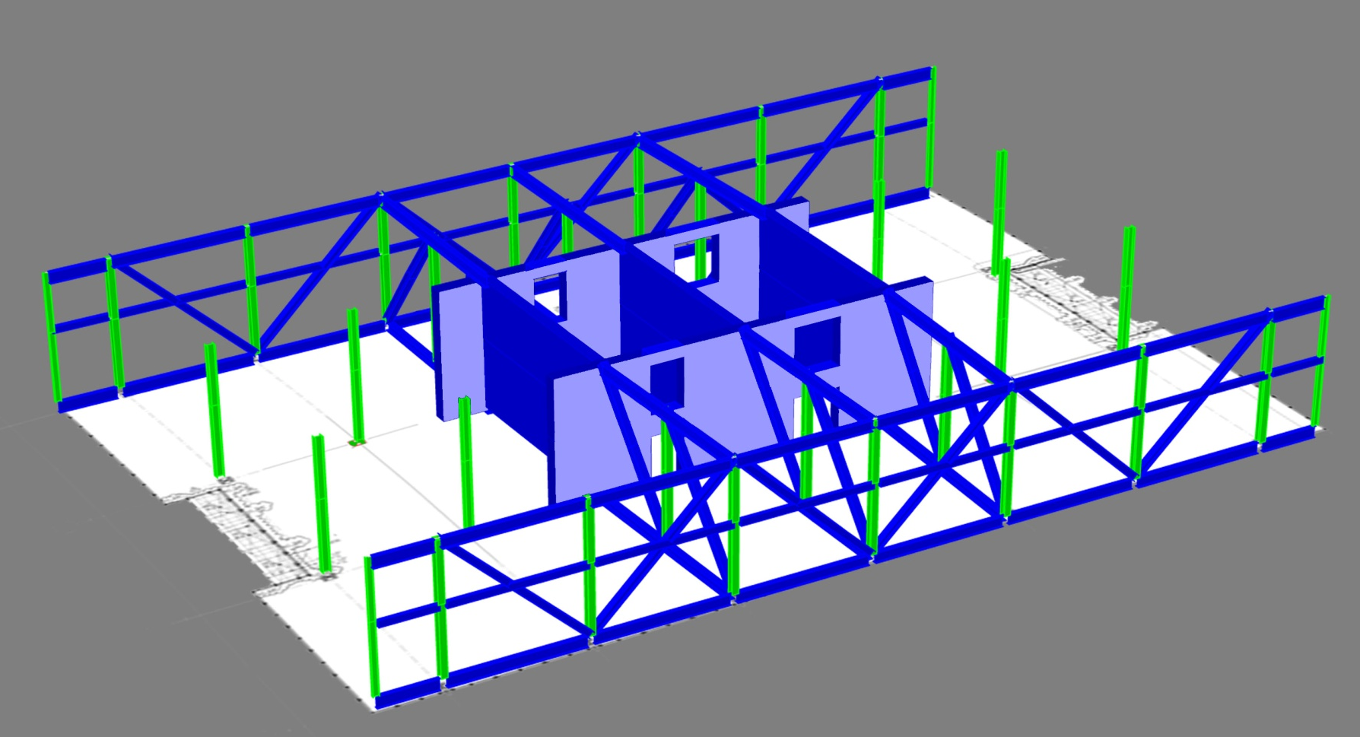
300 North La Salle
Existing Structure
Goals
Lateral Redesign
  1st Iteration
  2nd & 3rd Iterations
  Final Design
Architectural Impact
Acoustic Impact
Questions?
Key Points:
  Increased flange thicknesses
  2 – 7’ openings
  2 – 10’ openings
  1st Iteration Truss Configuration
    6 Outriggers
    2 Belts

Slide 20
300 North La Salle
Existing Structure
Goals
Lateral Redesign
  1st Iteration
  2nd & 3rd Iterations
  Final Design
Architectural Impact
Acoustic Impact
Questions?
Results:
  Peak Acceleration
    28 milli-g’s
  Periods of Vibration
    10% increase
    Target 10%

Slide 21
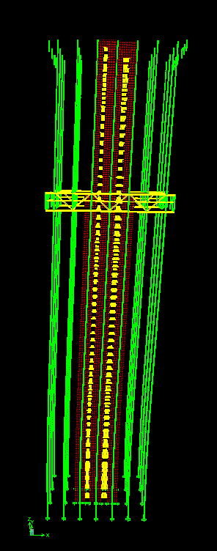
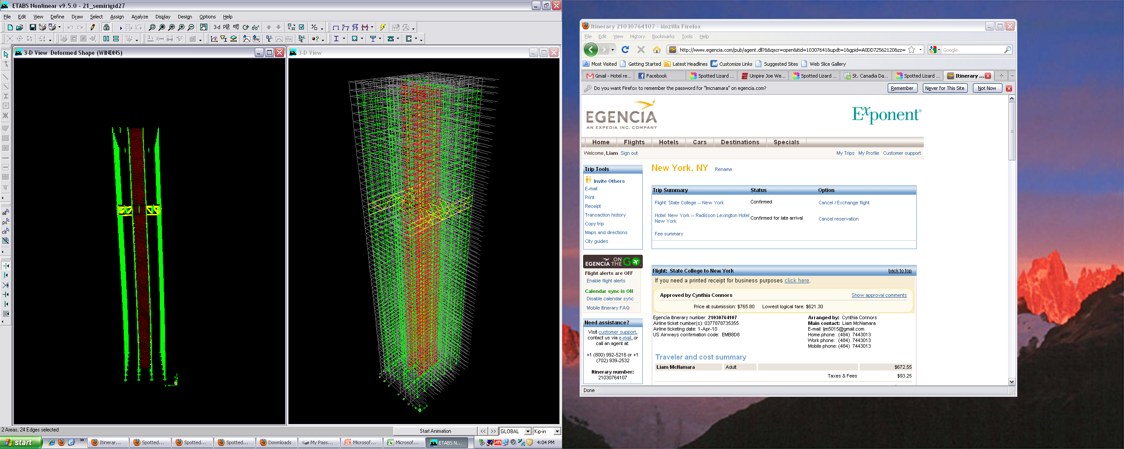
300 North La Salle
Existing Structure
Goals
Lateral Redesign
  1st Iteration
  2nd & 3rd Iterations
  Final Design
Architectural Impact
Acoustic Impact
Questions?
Drift Analysis:
  Wind Loads
    H / 400 Limit
    Max drift @ Roof’ = 21.5”
    Max allowable = 23.58”
  Seismic Loads
    0.020hsx
    Well under limit

Slide 22
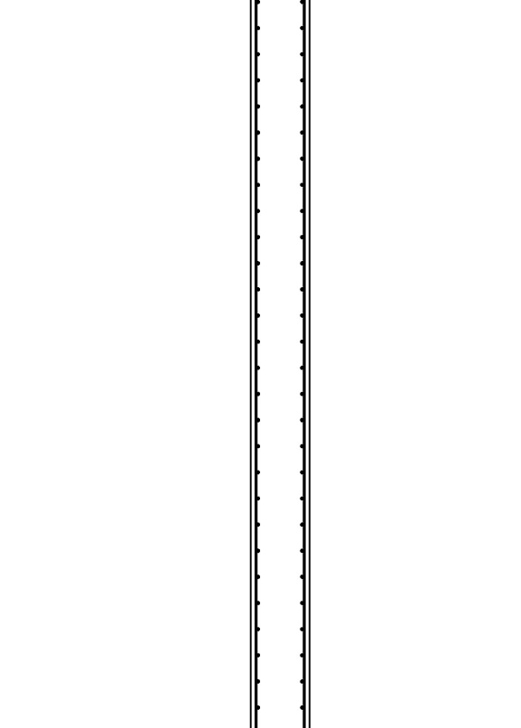
300 North La Salle
Existing Structure
Goals
Lateral Redesign
  1st Iteration
  2nd & 3rd Iterations
  Final Design
Architectural Impact
Acoustic Impact
Questions?
Reinforcement Design:
  Shear Reinforcement
  Wind loads calculated from ASCE 7-05
  Designed using ACI 318-08 Chapter 11
  Reinforcement ratio : 0.25%
Typical Shear Reinforcement

Slide 23
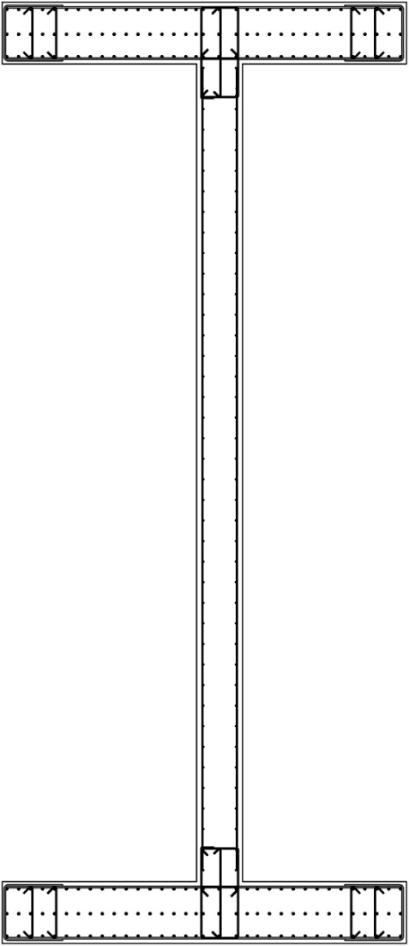
300 North La Salle
Existing Structure
Goals
Lateral Redesign
  1st Iteration
  2nd & 3rd Iterations
  Final Design
Architectural Impact
Acoustic Impact
Questions?
Reinforcement Design:
  Flexural Reinforcement
    Design moments from ETABS output
    As = (M_{W}/jd-P_{D}) / (∅fy)
    Checked with PCAColumn
    Max rho = 2%
    Additional flexural reinforcement req’d
    Lower Level 1 – Level 11
Lower Level 1 of Pier 6

Slide 24
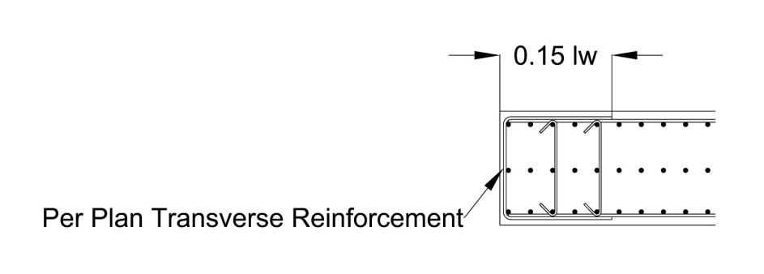
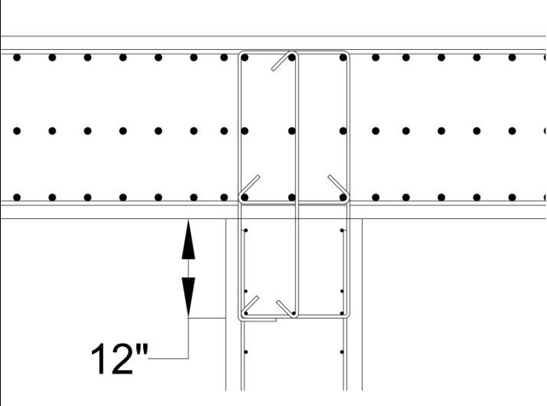
300 North La Salle
Existing Structure
Goals
Lateral Redesign
  1st Iteration
  2nd & 3rd Iterations
  Final Design
Architectural Impact
Acoustic Impact
Questions?
Reinforcement Design:
  Boundary Elements
  Control buckling of longitudinal reinforcement
  14” max horizontal spacing
  8” max vertical spacing
  U-stirrups per horizontal shear reinforcement
Flange at Openings
Lower Level 1 of Pier 6
Web and Flange Intersection

Slide 25
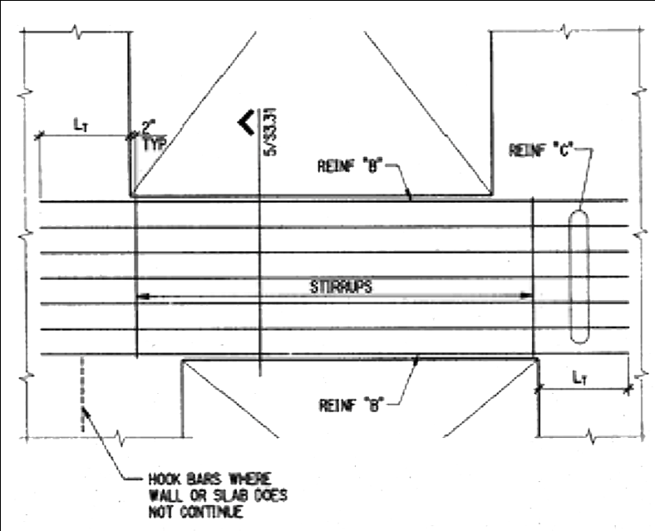
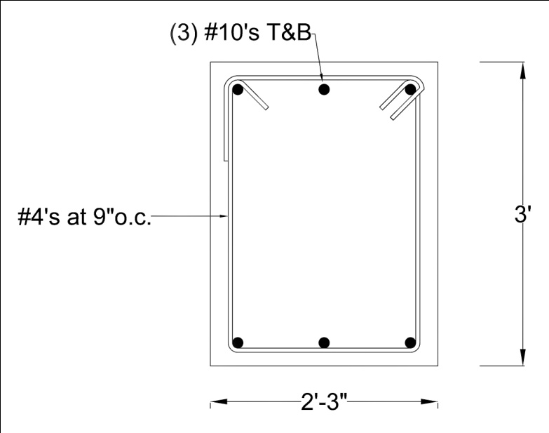
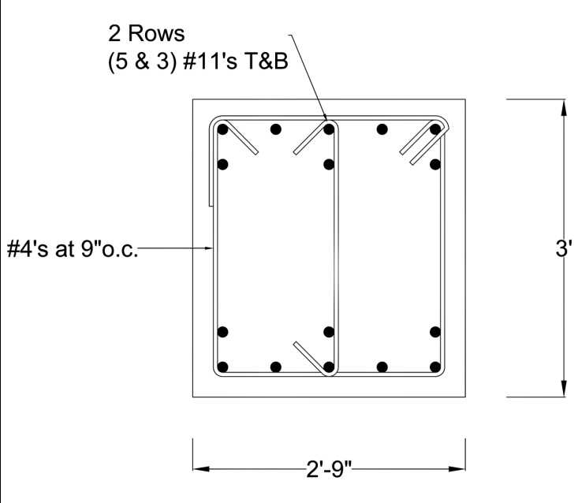
300 North La Salle
Existing Structure
Goals
Lateral Redesign
  1st Iteration
  2nd & 3rd Iterations
  Final Design
Architectural Impact
Acoustic Impact
Questions?
Reinforcement Design:
  Coupling Beam:
    20% shear reduction from grouping
    Designed to yield in flexure
Typical Beam Elevation
Group A – Level 43 - Level 55
Group B – Level 9 - Level 39

Slide 26
300 North La Salle
Existing Structure
Goals
Lateral Redesign
  1st Iteration
  2nd & 3rd Iterations
  Final Design
Architectural Impact
Acoustic Impact
Questions?
Things to Consider:
  Minimize inherent torsion
  Control wind drift
  Control wind acceleration
  Strength and Constructability
    Walls
    Beams
Final Design

Slide 27
300 North La Salle
Existing Structure
Goals
Lateral Redesign
  1st Iteration
  2nd & 3rd Iterations
  Final Design
Architectural Impact
Acoustic Impact
Questions?
Architectural Impact

Slide 28
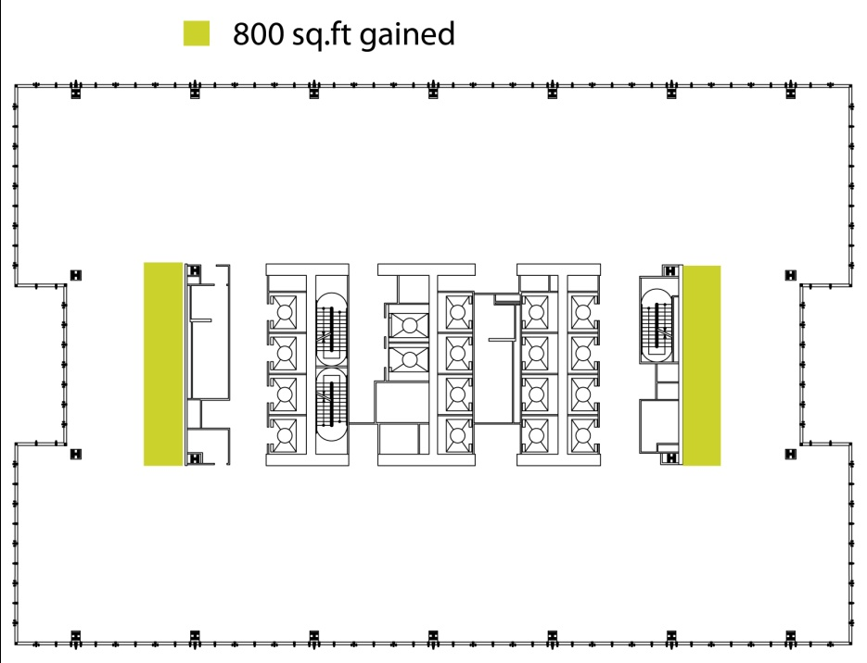
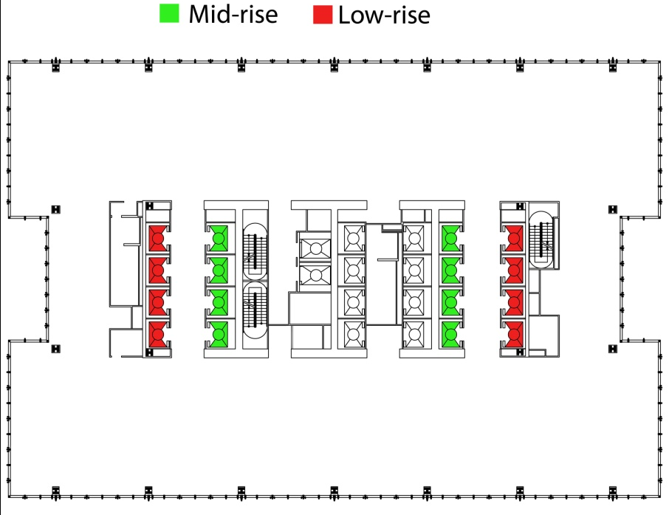
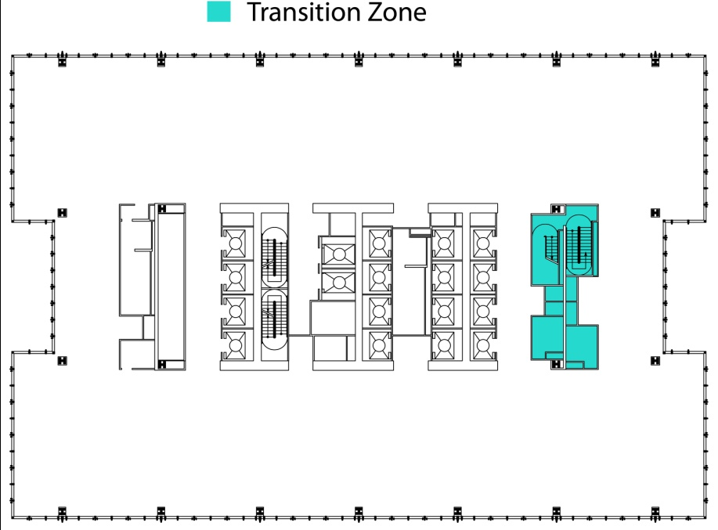
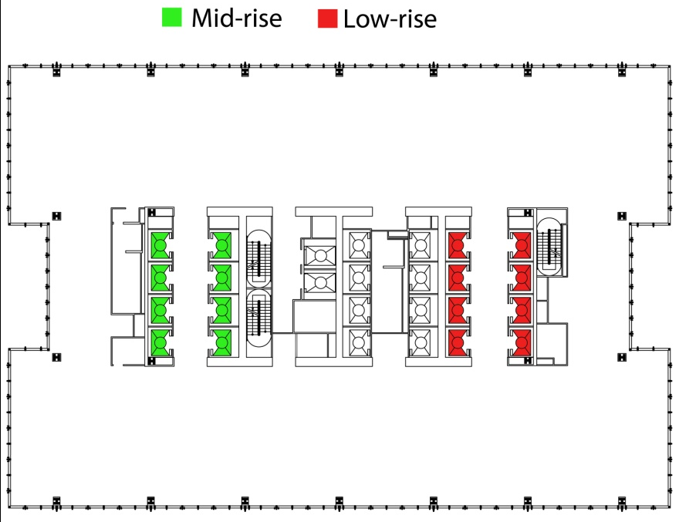
300 North La Salle
Existing Structure
Goals
Lateral Redesign
  1st Iteration
  2nd & 3rd Iterations
  Final Design
Architectural Impact
Acoustic Impact
Questions?
Key Changes:
  Core length reduced from 120’ to 80’
  Re-allocation of elevator bays
  900 sq.ft open floor space gained Level 29 – Level 40
  Shaft walls replaced with 2-hr fire-rated US Gypsum wall assemblies

Slide 29
300 North La Salle
Existing Structure
Goals
Lateral Redesign
  1st Iteration
  2nd & 3rd Iterations
  Final Design
Architectural Impact
Acoustic Impact
Questions?
Acoustic Impact

Slide 30
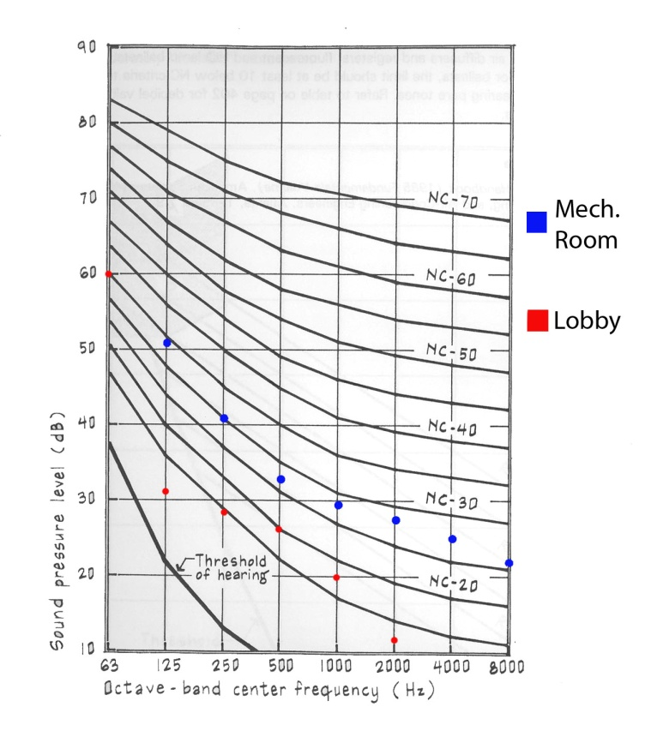
300 North La Salle
Existing Structure
Goals
Lateral Redesign
  1st Iteration
  2nd & 3rd Iterations
  Final Design
Architectural Impact
Acoustic Impact
Questions?
Key Points:
  Meet Noise Criteria rating – NC-35
  Check Mechanical Equipment Room
  Check Reception and Lobby
  Wall Assembly UL Des U415, System C
  STC 51

Slide 31
Evaluation / Conclusion:
300 North La Salle
Existing Structure
Goals
Lateral Redesign
  1st Iteration
  2nd & 3rd Iterations
  Final Design
Architectural Impact
Acoustic Impact
Questions?
Goals:
Reduce foot print of core
Redesign structural core
Eliminate belt trusses
Increase rentable floor space
Comply with original architecture
Things to Consider:
  Minimize inherent torsion
  Control wind drift
  Control wind acceleration
  Strength and Constructability
    Walls
    Beams

Slide 32
Thank You
The AE Faculty
My Advisor : Dr. Andres Lepage
Scott Timcoe – Hines
Dave Eckmann – MKA
My Friends and Family

Slide 33
Questions?
300 North La Salle
Existing Structure
Goals
Lateral Redesign
  1st Iteration
  2nd & 3rd Iterations
  Final Design
Architectural Impact
Acoustic Impact
Questions?

Slide 34
Bibliography:
Griffis, Lawrence G. "Serviceability Limit States Under Wind Load." Engineering Journal - AISC First Quarter (1993): 1-16. Print.
Egan, M. David. Architectural Acoustics. Ft. Lauderdale, FL: J. Ross Pub., 2007. Print.
Building Code Requirements for Structural Concrete (ACI 318-08) and Commentary: an ACI Standard. Farmington Hills, MI.: American Concrete Institute, 2008. Print.
Steel Construction Manual 13th edition. Chicago, Illinois: American Institute of Steel Construction, 2005. Print.

